Slide 1
S
c

Slide 2
h
o

Slide 3
o
l

Slide 4
C
o

Slide 5
u
n

Slide 6
c
i

Slide 7
l

Slide 8
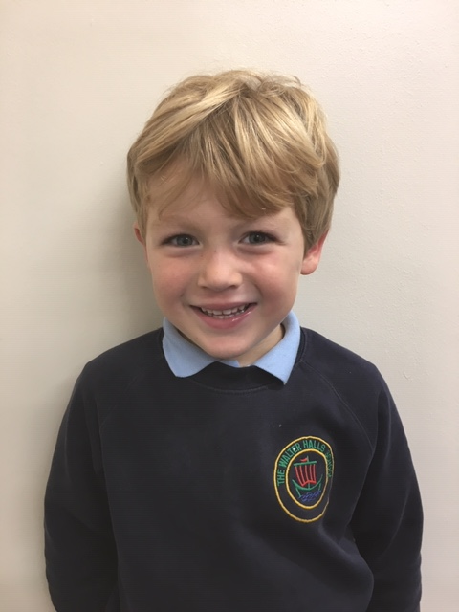
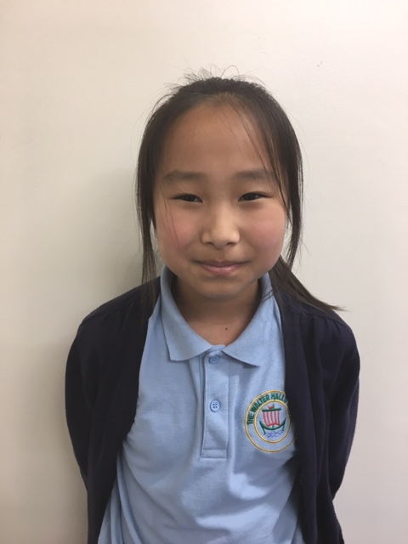
Ralph – 1A
Sara – 6A

Slide 9
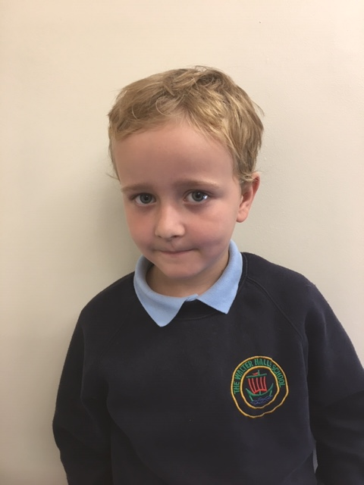
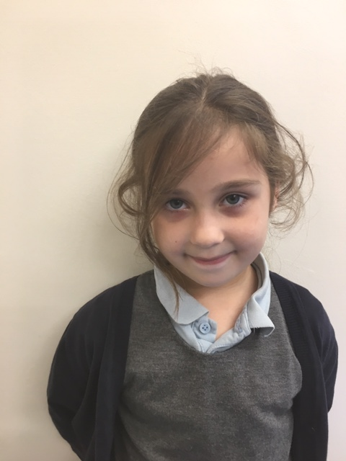
Jayden – 2A
Ella – 2B

Slide 10
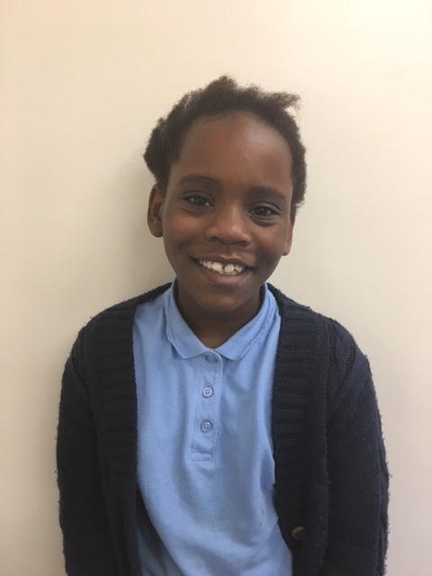
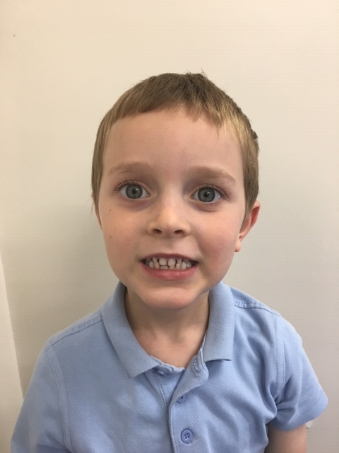
Mariella – 5A
Alexander – 1B

Slide 11
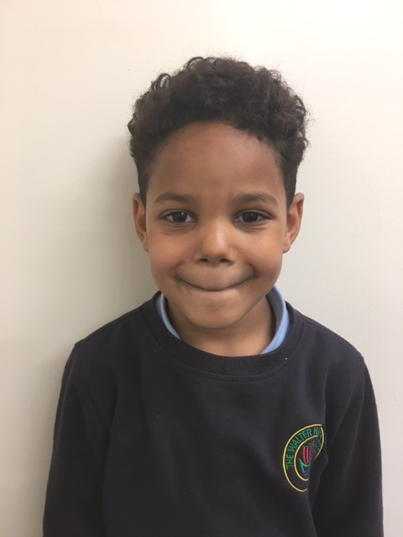
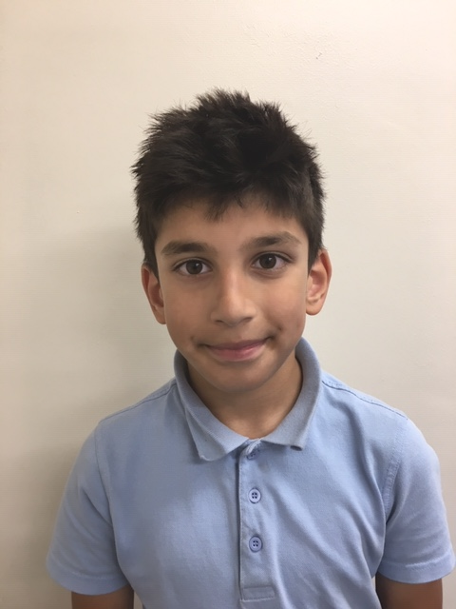
Eden – 3A
Adam – 4B

Slide 12
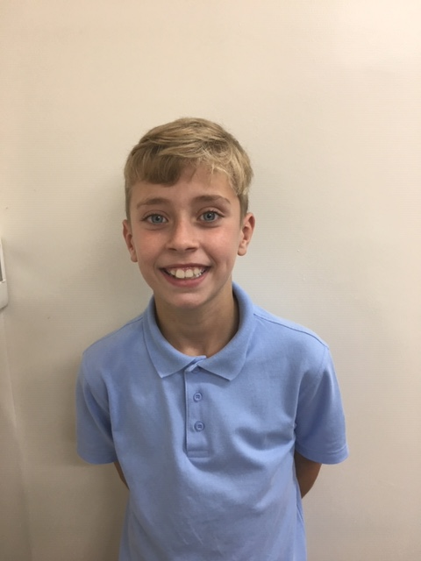
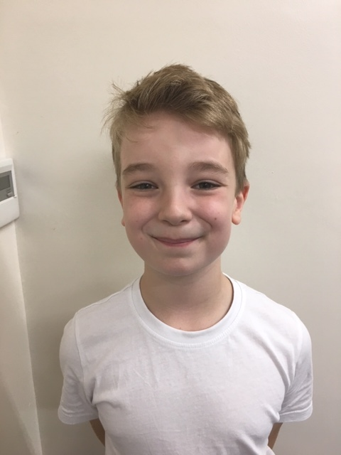
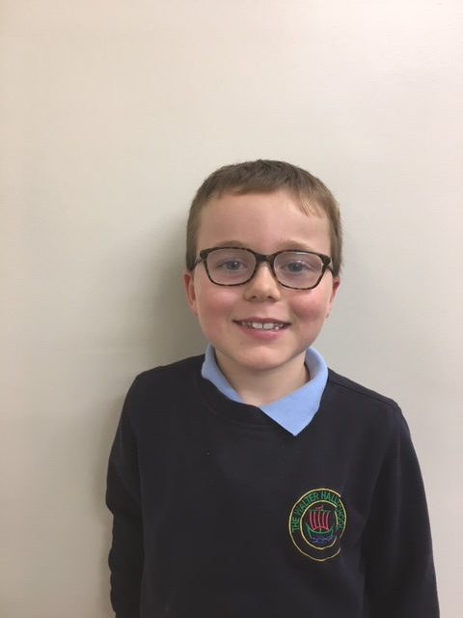
Evan – 5B
Jacob – 3B

Slide 13
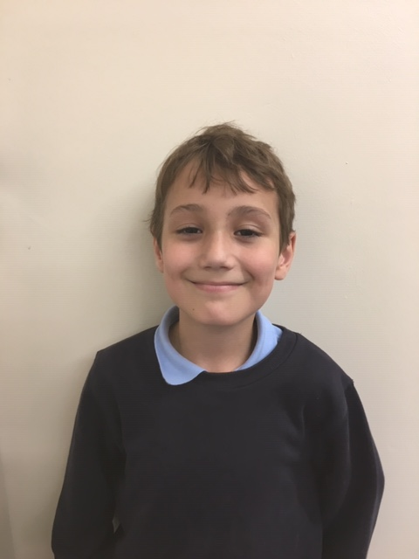
We want to make playtime and lunchtimes better for everyone!
Alfie – 4A

Slide 14
We want to make playtime and lunchtimes better for everyone!
We think everyone in school should be respected

Slide 15
Without our cleaners our school wouldn’t be a nice place to be!
Mr Lupton works really hard in this school!

Slide 16
We want to know which sports you want to learn!
We want better lunchtime equipment for everyone!

Slide 17
We are here to help the children! The children are the MOST important people in school!
We think some people need more help to make good choices

